Slide 1
Redis Basics:
Introduction to Fast Data Storage
Presented by: Mirazul Islam Software Engineer-II
Data Path Limited.

Slide 2
Agenda
Redis is ACIDic
Caching Strategies
Expiration Policies
What is Redis?
Questions to Consider before Caching
Redis in Action

Slide 3




What is Redis?
In-memory data structure store
NoSQL database
Key-Value data structure store
Single threaded

Slide 4
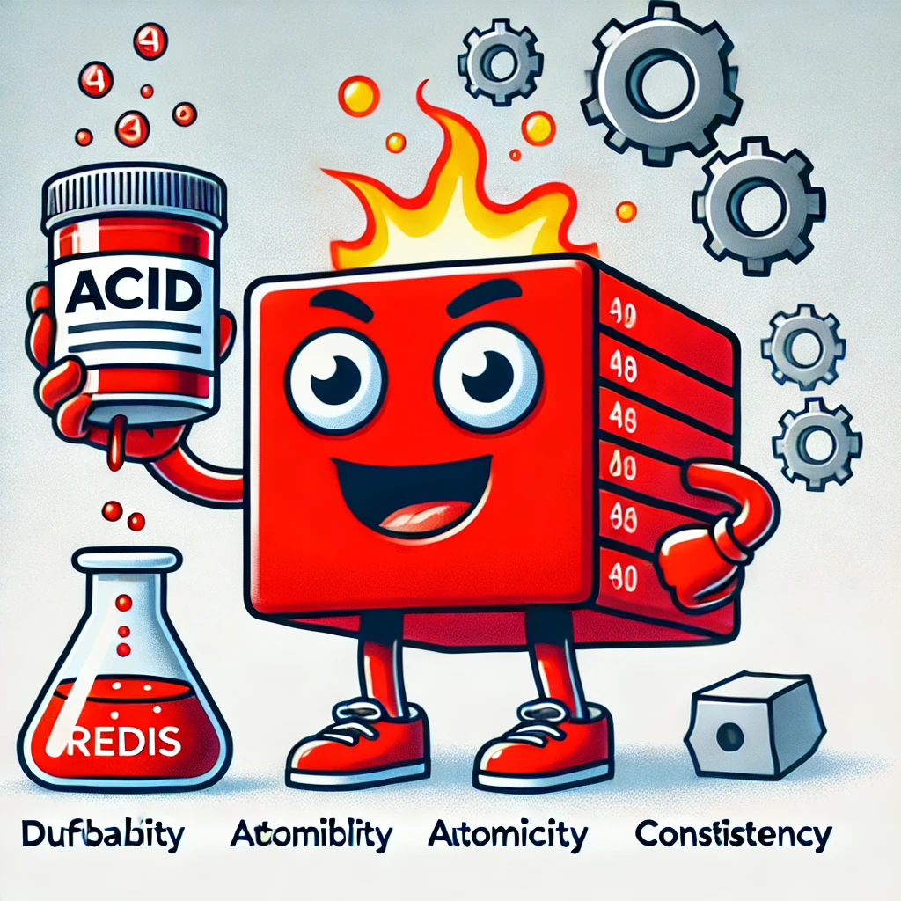
Redis is ACIDic
Atomicity
Consistency
Isolation
Durability

Slide 5
ACID in Redis - Atomicity
Redis commands (like SET, HSET) are atomic
No rollback mechanism for transactions

Slide 6
ACID in Redis - Consistency
Single instance always consistent
Potential temporary inconsistencies in distributed setups due to replication lag

Slide 7
ACID in Redis - Isolation
Single threaded
Commands inside transactions execute sequentially

Slide 8
ACID in Redis - Durability
RDB(Redis Database Backup)
can lose recent data during crashes
AOF(Append Only File)
provides better durability
may lose recent writes depending on settings

Slide 9
Caching Strategies
Write-Behind
Write-Through
Cache-Aside
Read-Through

Slide 10
Caching Strategies: Cache-Aside
1. Cache hit: read from cache
Cache
3. Write data to cache
2. Cache miss: read from database
Application
Database

Slide 11
Caching Strategies: Write-Through
Write to cache
Write to database
Application
Cache
Database

Slide 12
Caching Strategies: Write-Behind
Write to cache
Write to database
Application
Cache
Database

Slide 13
Caching Strategies: Read-Through
1. Hit: Read from cache
2. Read from database and
store in cache
Application
Cache
Database

Slide 14
Expiration Policies
AbsoluteExpirationRelativeToNow
SlidingExpiration

Slide 15
Questions to Consider before Caching
Am I using cache to avoid the core problem?
Is the data frequently queried?
Does the data update frequently?
Which cache strategy is the right fit?
How can I ensure cache consistency?

Slide 16
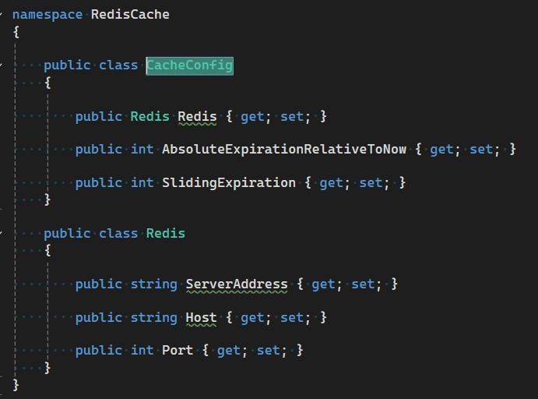
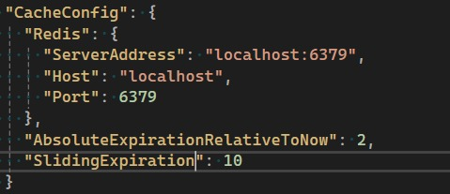
Redis in Action

Slide 17
